Slide 1

Evaluation Results for ICRIF 2018
International Conference
on Responsible and Inclusive Finance
ICRIF2018

Slide 2
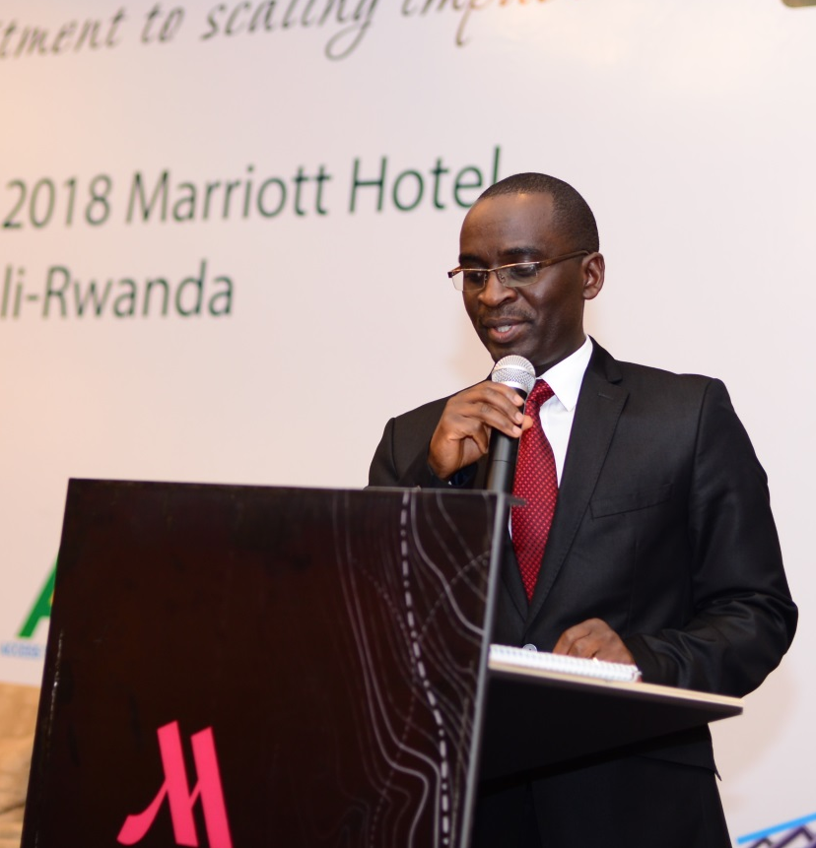
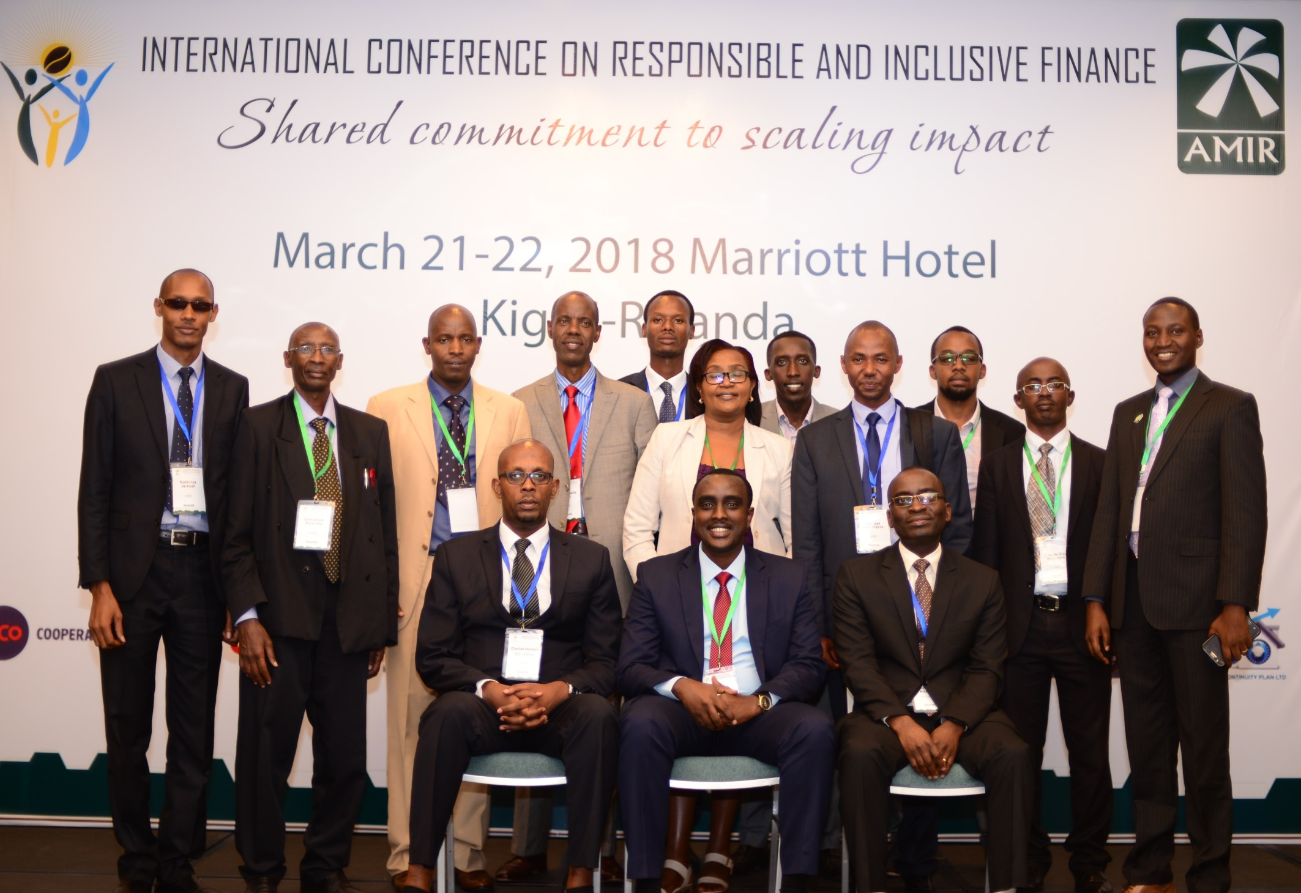
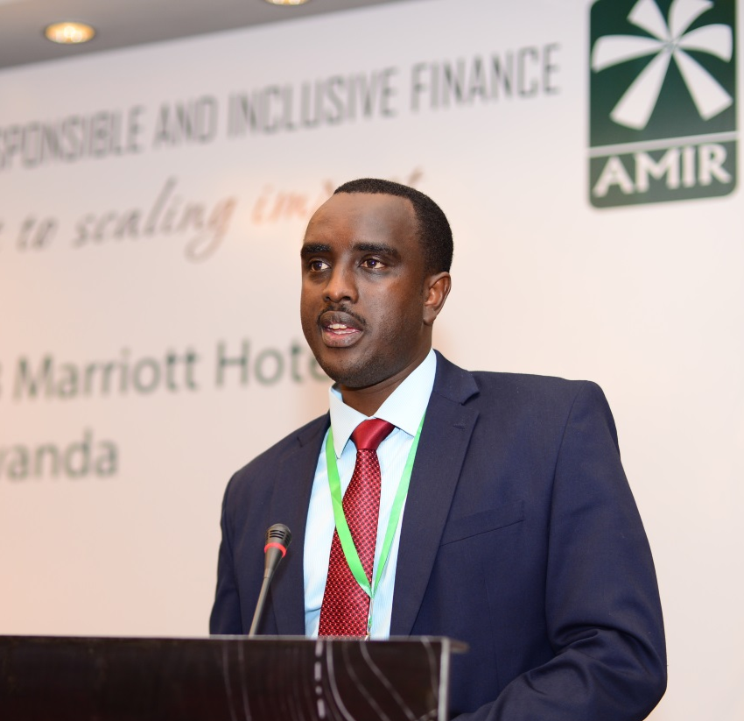


Slide 3
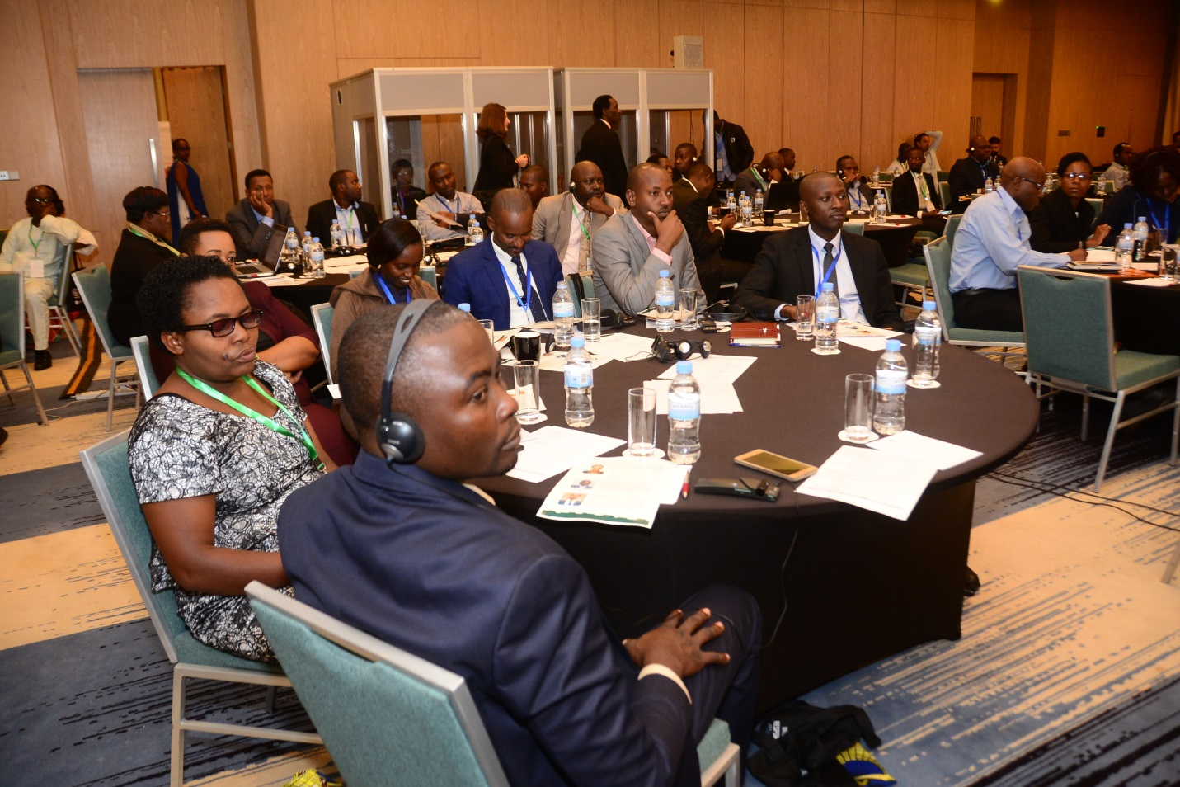
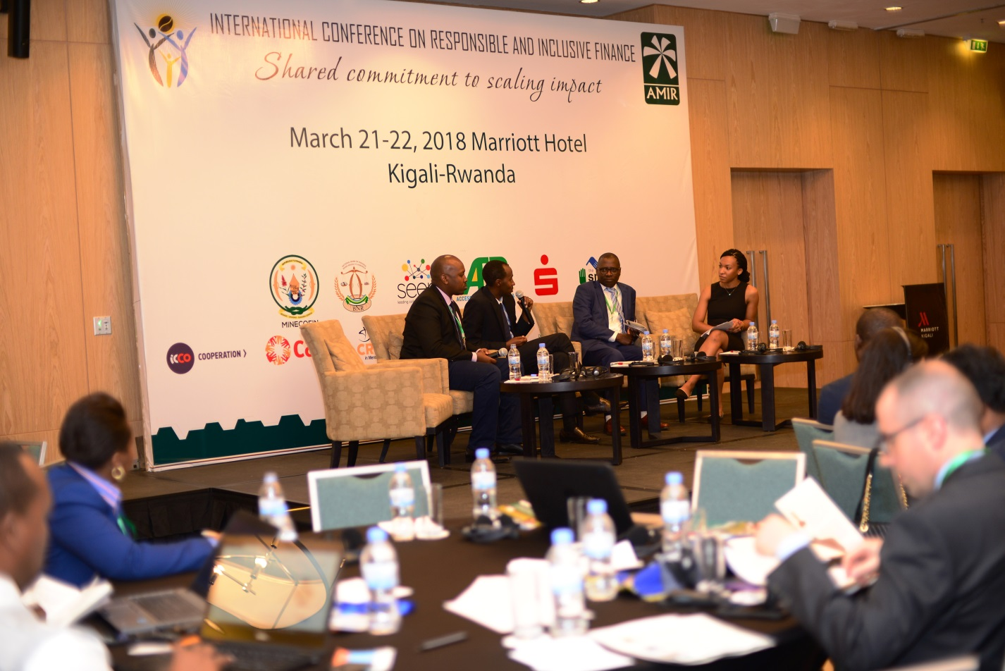

Slide 4
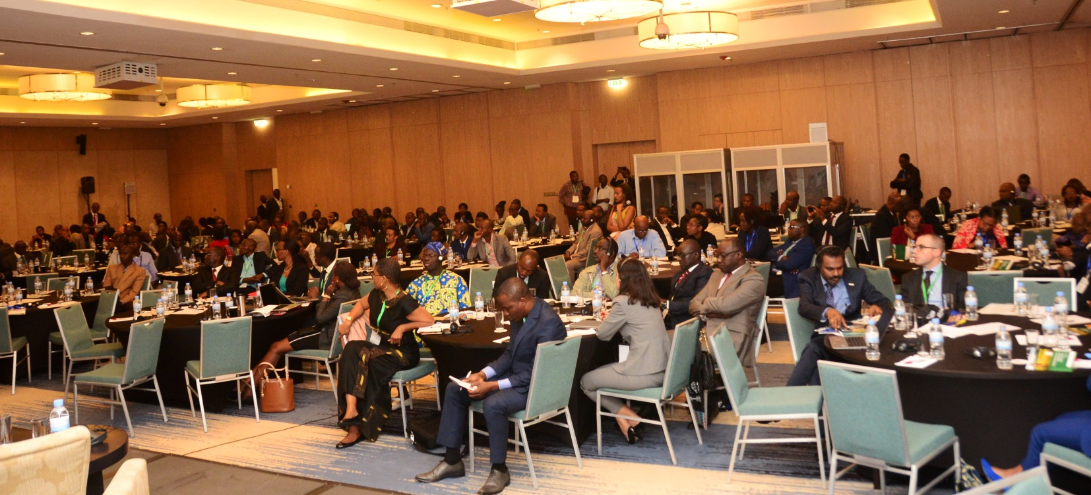
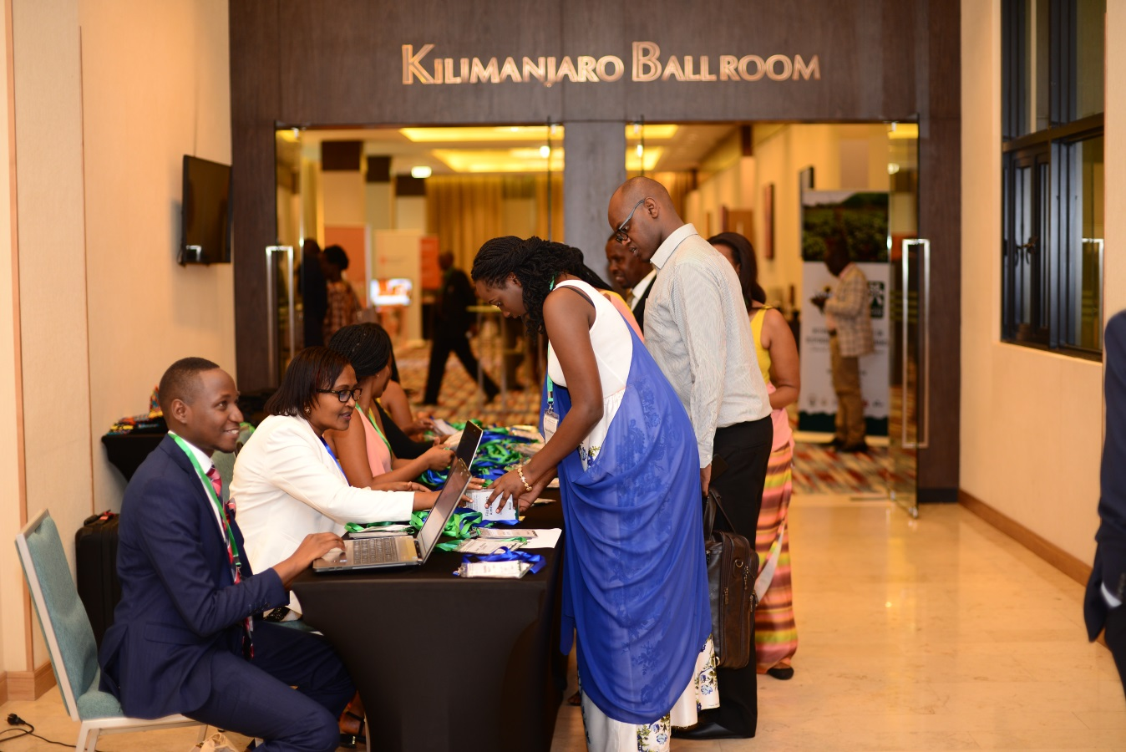
Quick Overview​
350 registrants​
249 attendees​
25 countries represented​
174 organizations represented​​
4 plenary sessions​
6 peer learning sessions​
4 trainings​

Slide 5
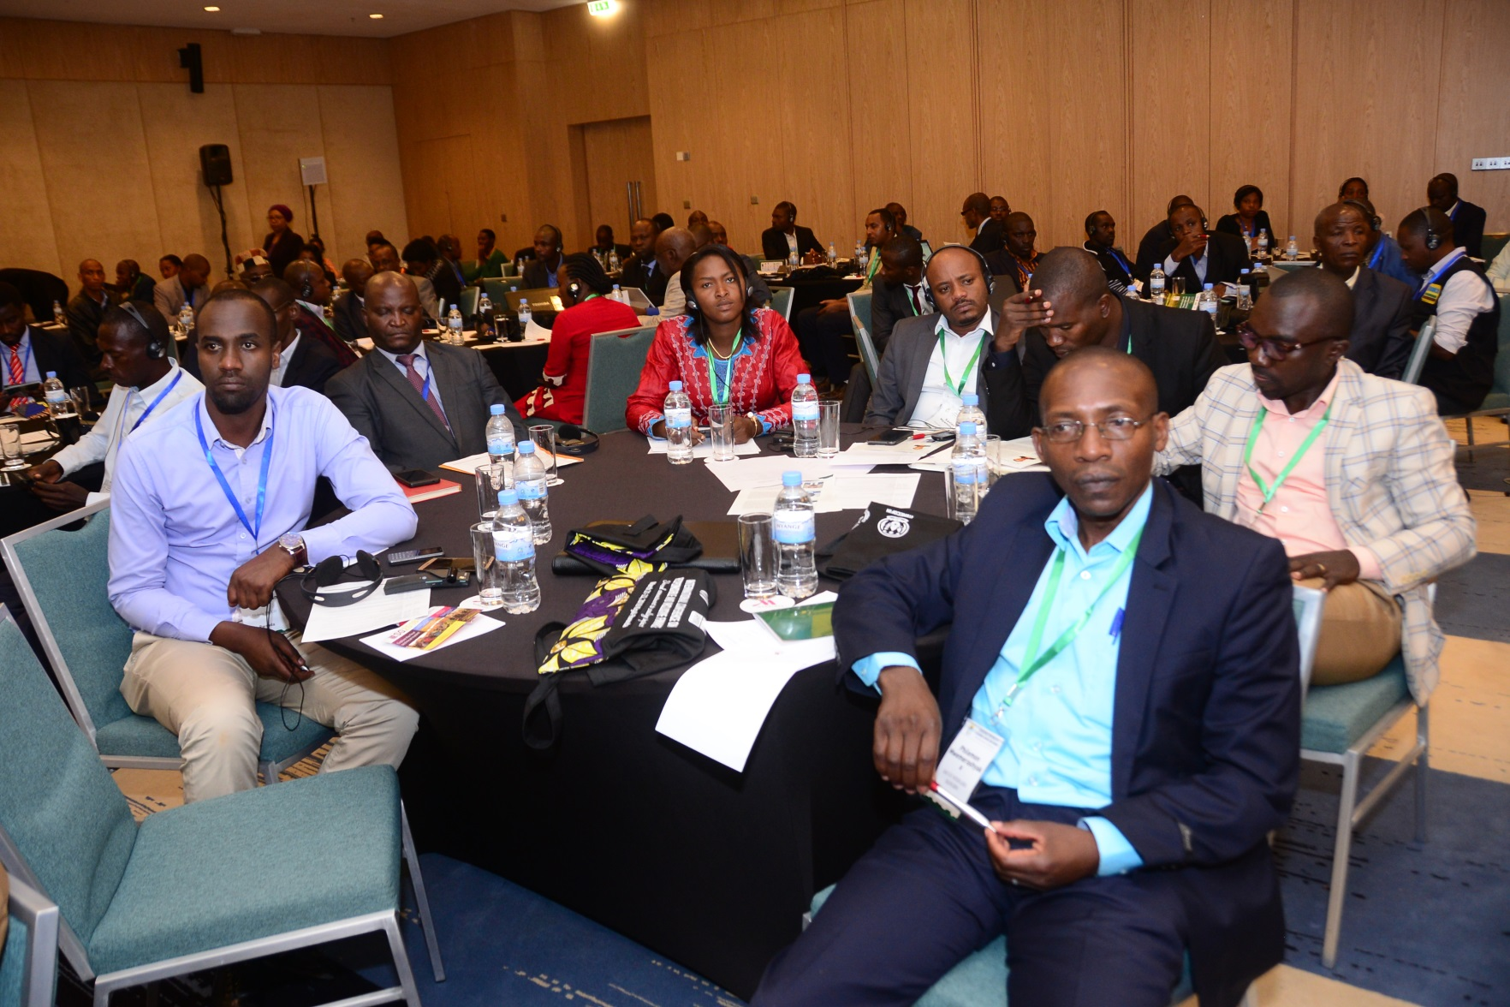
Participants by position type

Slide 6
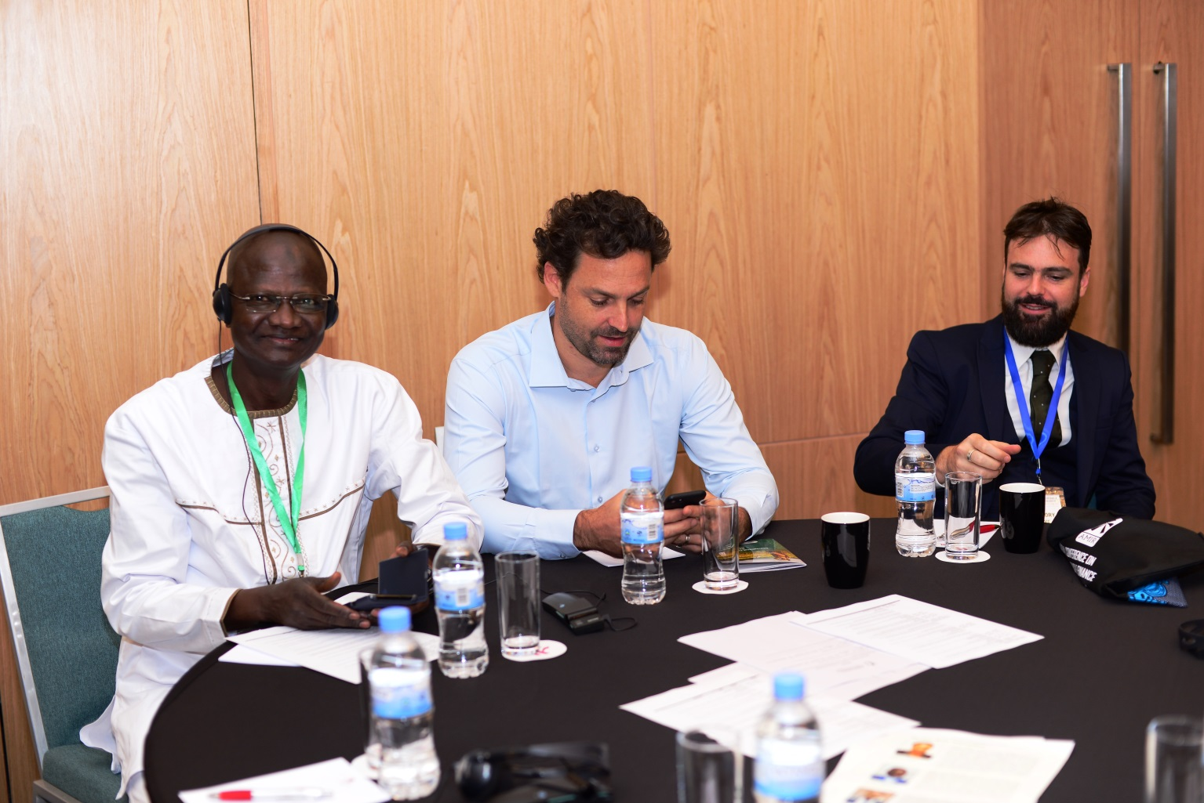
Participants by Geographic Region​

Slide 7
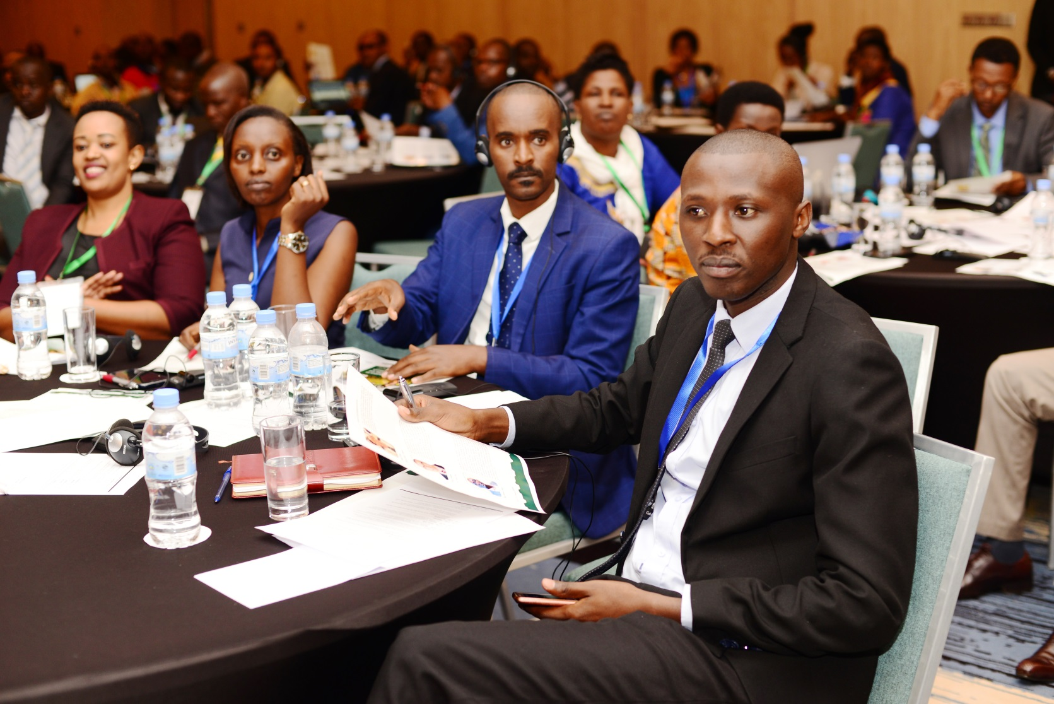
Participants by Geographic Region​

Slide 8
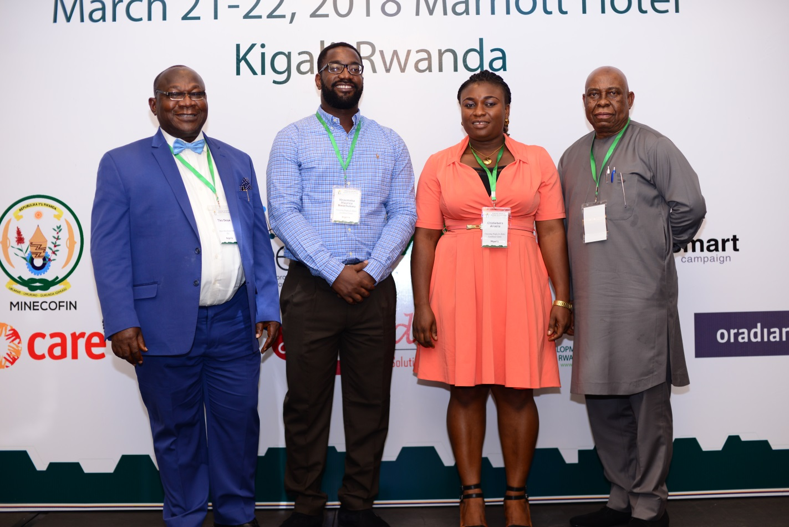
Participants by Organization Type​

Slide 9
Plenaries
Usefulness: | 4.22
Quality: | 4.29
-Most of the staff that was being discussed mainly applies to people/organizations that deal with the middle to high class clients but for the poor class, we have very little to learn.
Usefulness: | 4.14
Quality: | 4.20
-I feel we did not hear much about client experience. The main presentation was boring, mainly ready from notes. Very disappointing first session.
-Make the plenary more practical and interactive. This is not a classroom lecture.
-Taker more questions and include some success stories from different countries
-Need to improve on time management to allow more questions
-More practical examples of how enabling environments are impacting practitioners
-The presentation should have some examples from the project so far
-Great moderation
-Good panelists

Slide 10
Plenaries
Usefulness: | 4.15
Quality: | 4.16
Usefulness: | 4.22
Quality: | 4.35
-The discussion could not be more realistic and practical. A very informative engagement
-Good presentation but issues on using digital finance still there. Not much involvement for client protection.
-Great session. Very practical with good examples and a fun delivery. Great video.
-Practical
-Presenters master the subject/certification and are confident on the process they have gone through
It was all good! Keep it up!
-This is mostly for microfinance institutions but it was useful
-Provide more time for closer interaction with the audience

Slide 11
Plenaries
Usefulness: | 4.18
Quality: | 4.26

Slide 12
Peer Learning Sessions
Usefulness: | 4.28
Quality: | 4.33
-Very interactive session with lots of contribution from the floor
-Session was very beneficial and eye opening. This session was very critical for our understanding in Zimbabwe
Usefulness: | 4.44
Quality: | 4.44
-The speakers were knowledgeable. Very practical and useful

Slide 13
Peer Learning Sessions
Usefulness: | 4
Quality: | 4
Usefulness: | 4.12
Quality: | 4.08
-This session was interactive and very practical. My best session so far!
-Good presentation. I think in the end, the presentation was dictated by contributors from the floor thereby diverging from intended objective.
-It is good! We must put in practice!

Slide 14
Peer Learning Sessions
Usefulness: | 4.59
Quality: | 4.51
-Well done. Good initiative of helping children to be included in financial education
Usefulness: | 3.98
Quality: | 4.29
-Great work for sure, but the session could have been strengthened by data on factors for success on practice
-Excellent Moderator and choice of panelists-diverse!
-The program is very useful and interesting
-Good presentation and discussion. Well experienced presenters. Good job!

Slide 15
Peer Learning Sessions
Usefulness: | 4.27
Quality: | 4.33

Slide 16
Trainings
Usefulness: | 4.69
Quality: | 4.77
-Very well structured training, well summarized and getting to the point. I like the methodology used.
Usefulness: | 4.71
Quality: | 4.71
-Great program-could have used more time to explain all available avenues
-It's better to give us all these presentations through our email of registration. Don't forget the video regarding financial services certification.
-Very interactive approach. Adequately allowed for facilitator knowledge sharing and participant experience sharing and good depth for a short time-thanks much!
-It’s an interesting topic

Slide 17
Trainings
Usefulness: | 4.56
Quality: | 4.72
Usefulness: | 4.50
Quality: | 4.44
-Time wasn't enough for the entire topic
-It is very important to teach our clients members this section
-Interesting model that is well tailored to the microfinance sector. Very much interested
-Doing a step or 2 of the game to increase participation and engagement would be good. It would bring the game to life.
-The content is great!

Slide 18
Trainings
Usefulness: | 4.59
Quality: | 4.67

Slide 19
Overall
Reliability:
Speakers at the conference were competent and effective at facilitating discussion
The conference theme covered key issues in the industry
Assurance:
My time was well spent at this conference
Session topics were relevant to my work
Tangibility:
Pre-event communication and printed materials were informative, well presented and useful
The conference venue was well-organized and favorable to deriving the most benefit from the various sessions
Empathy:
The agenda was flexible enough to engage, break and refocus
My questions and comments were taken into consideration by the speakers and/or conference organizers
Responsiveness:
1. The AMIR staff were courteous, helpful, and attentive to my needs during the conference

Slide 20
Overall

Slide 21

To all of those who contributed to ICRIF2018, thank you for your excellent work! It’s fair to conclude that the Conference was a great success!

Slide 22
